Slide 1
Battle of neighborhoods TORONTO
Gopal KANNIAPPAN

Slide 2
Problem at hand
Identifying a suitable neighbourhood Toronto, to open a South Indian Coffee-shop.
Revelations of Initial Analysis
Data Science team has zeroed in on Scarborough, Toronto; because as per the 2016 statistics available on Wikipedia, Tamils are predominantly (around 43%) in Scarborough compared to the other Boroughs of Toronto.

Slide 3
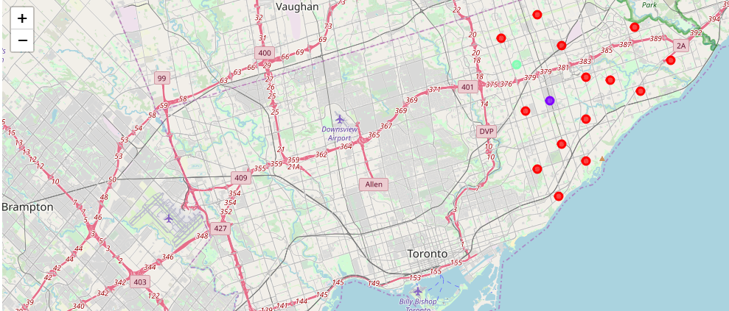
WE RECOMMEND…
First Cluster:
Rouge, Malvern, Woburn, Highland Creek, Rouge Hill, Port Union.
Highly Recommended
Second Cluster:
Dorset Park, Scarborough Town Centre, Wexford
Recommended
Third Cluster:
Clarks Corners, Sullivan, Tam O’Shanter
Not recommended

Slide 4
FINAL REPORT
You can access the complete report of this project here.

Slide 5
THANK YOU!

